Slide 1
Dot Net Framework

Slide 2
What is Framework?
In software development, a Framework is a defined support structure in which another software project can be organized and developed. Typically, a framework may include support programs, code libraries and a scripting language amongst other software to help develop and glue together the different components of your project.

Slide 3
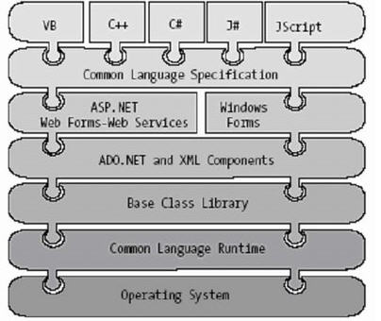
Basic Framework

Slide 4
The most important features of .NET
􀂄 Assemblies
􀂄 Metadata
􀂄 Common Type System
􀂄 Common Intermediate Language
􀂄 Common Language Runtime
􀂄 Deploying .NET Runtime
􀂄 Garbage Collection
􀂄 Serialization

Slide 5
.NET Benefits
In comparison with previous Microsoft’s technologies:
Simplified programming model – no error codes
Run once, run always – no "DLL hell"
Simplified deployment – easy to use installation projects
Wide platform reach
Programming language integration
Simplified code reuse
Automatic memory management (garbage collection)
Rich debugging support – CLR debugging, language independent
Consistent method failure paradigm – exceptions
Security – code access security
Interoperability – using existing COM components, calling Win32 functions

Slide 6
.NET Programming Languages
􀂄 Examples:
􀂄 C#
􀂄 Managed Extensions for C++
􀂄 Java - Visual J# .NET
􀂄 JavaScript - JScript .NET
􀂄 Perl
􀂄 Pascal, Delphi
􀂄 PHP
􀂄 Smalltalk

Slide 7
.NET Assembly’s Format
􀂄 .NET assembly consists of the following elements:
􀂄 Win32 File Header
􀂄 CLR File Header
􀂄 CIL code
􀂄 type metadata
􀂄 assembly manifest
􀂄 optional embedded resource

Slide 8
Single-File and Multifile Assemblies
In a great number of cases, there is a simple one-to-one
correspondence between a .NET assembly and the binary file
(.dll or .exe)
this is single-file assembly
Multifile assemblies are composed of numerous .NET binaries
(modules)
􀂄 one of these modules (primary module) must contain the
assembly manifest
􀂄 multifile assemblies allow to use more flexible deployment
option (e.g. the user is forced to download only selected
modules)

Slide 9
Private Assemblies
Private assemblies are required to be located in application’s directory or subdirectory
Identification of a private assembly:
name of the module that contains the assembly’s manifest
(without an extension)
version number

Slide 10
Shared Assemblies
Single copy of a shared assembly can be used by several
applications on a single machine
A shared assembly should be installed into the Global
Assembly Cache (GAC), located in Assembly subdirectory
of Windows directory
since VS 2005 also *.exe files can be installed into the GAC
(previously only *.dll files were accepted)
To list content of the GAC, install a new assembly, or
uninstall an assembly, use gacutil.exe utility
installing an assembly:
gacutil.exe –i MyAssembly.dll
Two or more assemblies of the same name can coexist in
the GAC (must have different versions)
the end of "DLL hell"

Slide 11
Signing an Assembly
Only assemblies signed using a strong name can be installed into the GAC
Signing an assembly:
1. Use the sn.exe utility to generate a .snk file with public/private key information
sn –k MyKey.snk
2. Apply the .snk file to the assembly (using
AssemblyKeyFile attribute or by setting project’s properties in Visual Studio)
3. Compile the assembly

Slide 12
Assembly Manifest
Manifest is a piece of metadata which describes the assembly
itself
Manifest documents all external assemblies required by the
current assembly to function correctly
Content of a manifest:
  the name of the assembly
  the version of the assembly
􀂄 the shared name for the assembly
􀂄 information about the type of environment the assembly
supports (e.g. operating system and languages)
􀂄 list of files in the assembly
􀂄 list of all other assemblies this assembly references

Slide 13
.NET Type Metadata
.NET assembly contains full, complete and accurate
metadata, which describes:
  all types (classes, structures, enumerations)
  all members of types (methods, properties, events etc.)
  Metadata is emitted by a compiler
Some benefits of using metadata:
no need to register in a system (unlike COM objects)
no need for header files
tips from IntelliSense in Visual Studio
crucial for some .NET technologies, e.g. remoting, reflection,
late binding, XML web services, and object serialization
garbage collection

Slide 14
Reflection
Reflection is a process of runtime type discovery
Allows to programmatically obtain metadata information
System.Reflection namespace:
Assembly, AssemblyName, EventInfo, FieldInfo,MemberInfo, MethodInfo, Module, ParameterInfo,PropertyInfo
System.Type class

Slide 15
Common Type System (CTS)
Types in .NET
classes (sealed classes, implementing interfaces, abstract classes, internal or public classes)
structures
interfaces (named collections of abstract member definitions)
enumerations
delegates (equivalent of type-safe function pointer)
CTS is a formal specification that documents how types must be defined in order to be hosted by the CLR

Slide 16
Intrinsic CTS Data Types
CTS Data Type | VB.NET | C# | Managed C++
System.Boolean | Boolean | bool | Bool
System.Decimal | Decimal | decimal | Decimal
System.String | String | string | String^
System.Char | Char | char | wchar_t
System.Object | Object | object | Object^
System.Double | Double | double | Double
System.Single | Single | float | Float

Slide 17
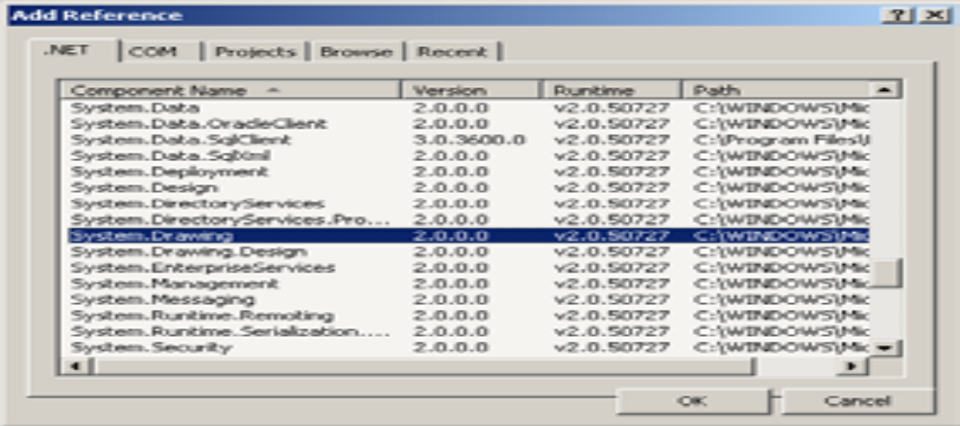
Referencing External Assemblies
To use types from external assembly:
1. Add a reference to the project
2. Use fully qualified names or utilize using directive
System.Drawing.Bitmap bmp =
new System.Drawing.Bitmap(50, 50);
using System.Drawing;

Slide 18
Deploying .NET Runtime
.NET assemblies can be executed only on a machine that has the .NET Framework installed
.NET Framework 1.1 was included in Windows Server 2003
and was an optional component of Windows XP Service Pack 1
Redistributable packages (dotnetfx.exe)
.NET Framework 1.1
  23.1 MB
  Windows 98/Me/NT/2000/XP/2003, IE 5.01
.NET Framework 2.0
  22.4 MB
  Windows 98/Me/NT/2000/XP SP2/2003, IE 5.01
  Windows Installer 3.0
  disk space: 280 MB (x86), 610 MB (x64)

Slide 19
Garbage Collection (GC)
.NET objects are allocated onto a region of memory termed
the managed heap
They will be destroyed by the garbage collector
  make no assumption about time of destruction
Garbage collection (an attempt to free up memory) will be performed when CLR determines that the managed heap does not have sufficient available memory
  all active threads are suspended
  special GC thread tries to free memory
  suspended threads are waken up
  GC in .NET is highly optimized

Slide 20
Forcing a Garbage Collection
Sample scenarios when forcing a garbage collection can be useful:
the application is about to enter a block of code which should not be interrupted
the application has just finished allocating an extremely large
number of objects and as much memory as possible should be
freed
GC.Collect();
GC.WaitForPendingFinalizers();

Slide 21
Disposable Objects
public class MyClass : IDisposable
{
public void Dispose()
{
// here dispose all memory
// - all unmanaged resources
// - call Dispose() method of all contained
// disposable objects
}
}
using (MyClass mc = new MyClass()) {
// ... using mc object
} // here Dispose() method is called automatically

Slide 22
Serialization
Serialization is a process of persisting (and possibly
transferring) the state of an object to a stream
The persisted data sequence contains all necessary information needed to reconstruct (deserialize) the state of the object
When an object is persisted to a stream, all associated data (base classed, contained objects, etc.) are automatically serialized as well
It allows to persist an object graph in a variety of formats
Full set of related objects (so-called object graph) is serialized
All objects in an object graph to serialize must be marked with the [Serializable] attribute
Formatters available in .NET 2.0:
􀂄 BinaryFormatter – compact binary format
􀂄 SoapFormatter – SOAP message
􀂄 XmlFormatter – XML document

Slide 23
History
Next Generation Windows Services, late 90s
.NET Framework 1.0, 05.01.2002
.NET Framework 1.1, 01.04.2003
  Bug fixes + API changes
  .NET Compact Framework
.NET Framework 2.0, 07.11.2005
  Bug fixes + API changes
  Full 64 bit support
  Language support for generics
  New controls

Slide 24


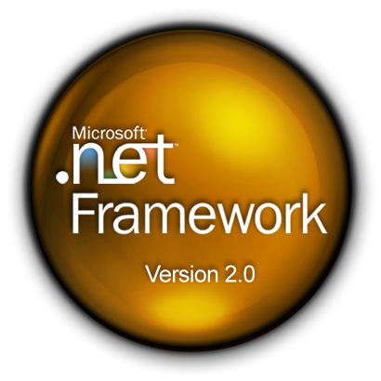



.NET Framework Version 3.0

Slide 25
Windows Presentation Foundation
Avalon
Framework for User Interfaces
Replaces Windows Forms and GDI / GDI+
One framework for:
  Forms
  Media
  3D Graphics
  Animations
  Documents

Slide 26
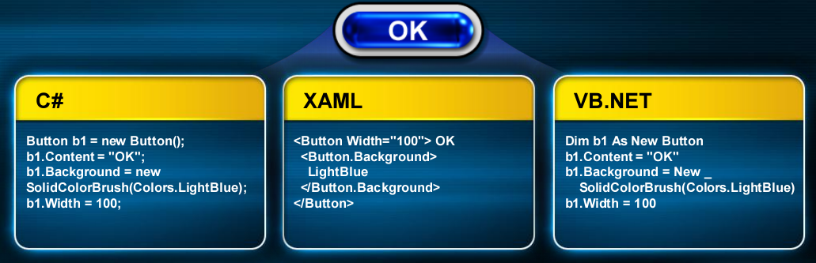
XAML
eXtensible Application Markup Language

Slide 27




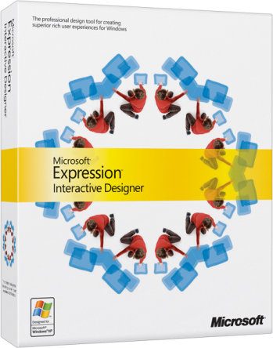
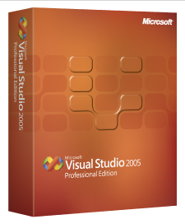
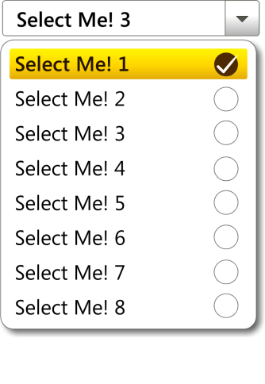
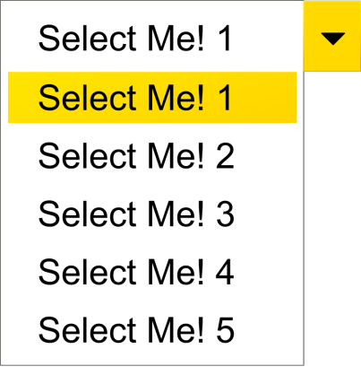
XAML
Designer
Emotional Connection
Look, behavior, data visualization, usability, brand impact
Developer
Functional Capabilities
Deployment, function, data connection and integrity, IT process, security
Paper
JPG / TIFF
MOV / WMV
PSD
PPT
C++
C#
VB.NET
XAML

Slide 28
Windows Communication Foundation
Windows Communication Foundation, or just WCF, is a programming framework used to build applications that inter-communicate.
Indigo
Support for Service Oriented Applications (SOA)
Service Oriented Architecture

Slide 29
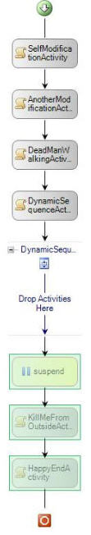
Why Workflow?
Workflow technology makes it possible to automate business processes to increase the overall accuracy, efficiency and predictability of the logical activities coordinated within a process. Workflow increases visibility into a complex process and facilitates better communication between business users and technology.

Slide 30
Windows Card Space
The Windows CardSpace software enables people to maintain a set of personal digital identities that are shown to them as visual “Information Cards”. These cards are easier to use than passwords. Furthermore, they employ strong cryptography, making them significantly more secure than passwords and other information typed into web forms.
InfoCard
Digital Identity
Identity Provider

Slide 31
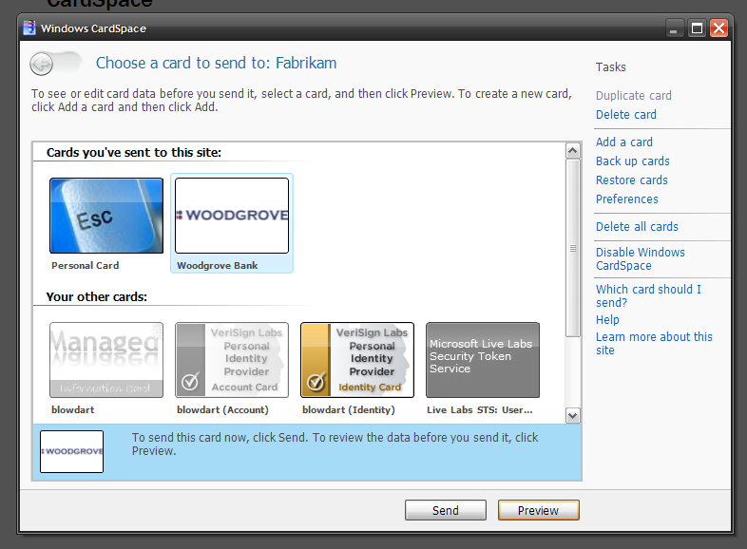
Windows Cardspace login Screen

Slide 32
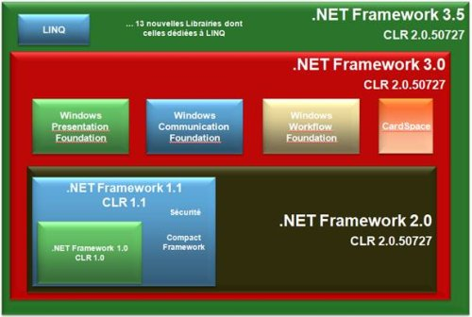
Framework V3.5

Slide 33
New Features in ASP.NET 3.5
ASP.NET AJAX
In ASP.NET 2.0, ASP.NET AJAX was used as an extension to it. You had to download the extensions and install it. However in ASP.NET 3.5, ASP.NET AJAX is integrated into the .NET Framework, thereby making the process of building cool user interfaces easier and intuitive.
The integration between webparts and the update panel is much smoother. Another noticeable feature is that you can now add ASP.NET AJAX Control Extenders to the toolbox in VS2008. Even though this is an IDE specific feature, however I feel it deserves a mention over here for developers, who had to add extenders using source view earlier. It is also worth noting that Windows Communication Foundation (WCF) now supports JSON along with other standard protocols like SOAP, RSS and POX.

Slide 34
New Features in ASP.NET 3.5
New Controls
The ListView and DataPager are new controls added along with a new datasource control called the LinqDataSource.
ListView
The ListView control is quiet flexible and contains features of the Gridview, Datagrid, Repeater and similar list controls available in ASP.NET 2.0. It provides the ability to insert, delete, page (using Data Pager), sort and edit data. However one feature of the ListView control that stands apart, is that it gives you a great amount of flexibility over the markup generated. So you have a complete control on how the data is to be displayed. You can now render your data without using the <table> tag. You also get a rich set of templates with the ListView control.
DataPager
DataPager provides paging support to the ListView control. The best advantage is that you need not have to keep it ‘tied’ with the control on which the paging is being done. You can keep it anywhere on the page.
DataPager gives you a consistent way of paging with the controls that support it. Currently only ListView supports it as it implements the IPageableItemContainer. However support is likely to be added to other List controls as well.

Slide 35
New Features in ASP.NET 3.5
LINQ
LINQ (Language Integrated Query) adds native data querying capability to C# and VB.NET along with the compiler and Intellisense support. LINQ is a component of .NET 3.5. LINQ defines operators that allow you to code your query in a consistent manner over databases, objects and XML. The ASP.NET LinqDataSource control allows you to use LINQ to filter, order and group data before binding to the List controls.
ASP.NET Merge Tool
ASP.NET 3.5 includes a new merge tool (aspnet_merge.exe). This tool lets you combine and manage assemblies created by aspnet_compiler.exe. This tool was available earlier as an add-on.

Slide 36
New Features in ASP.NET 3.5
New Assemblies
The new assemblies that would be of use to ASP.NET 3.5 developers are as follows:
· System.Core.dll - Includes the implementation for LINQ to Objects
· System.Data.Linq.dll - Includes the implementation for LINQ to SQL
· System.Xml.Linq.dll - Includes the implementation for LINQ to XML
· System.Data.DataSetExtensions.dll - Includes the implementation for LINQ to DataSet
· System.Web.Extensions.dll: Includes the implementation for ASP.NET AJAX (new enhancements added) and new web controls as explained earlier.
Some Other Important Points
1. ASP.NET 3.5 provides better support to IIS7. IIS7 and ASP.NET 3.5 modules and handlers support unified configuration.
2. You can have multiple versions of ASP.NET on the same machine.
3. For those who are wondering what happened to ASP.NET 3.0, well there isn’t anything called ASP.NET 3.0.
4. VS 2002 worked with ASP.NET 1.0, VS 2003 worked with ASP.NET 1.1, and VS 2005 worked with ASP.NET 2.0. However VS 2008 supports multi-targeting, i.e it works with ASP.NET 2.0, and ASP.NET 3.5.

Slide 37
Dot Net Framework 4.0…
Parallel Computing : A new programming model for writing multithreaded and asynchronous code that greatly simplifies the work of application and library developers
Dynamic Language Runtime : It is a new runtime environment that adds a set of services for dynamic languages to the CLR. The DLR makes it easier to develop dynamic languages to run on the .NET Framework and to add dynamic features to statically typed languages.
Background garbage collection
Profiling : cWe Can attach profilers to a running process at any point, perform the requested profiling tasks, and then detach.
Exceptions Handling - System.Runtime.ExceptionServices namespace, and adds the ability to handle corrupted state exceptions
Querystring Length: We can now change querystring length for server side request using following tag in web.config file – maxQueryStringLength

Slide 38
Thank You

